Slide 1

NLP Humor Detection Model
Using Multiple Embedding Techniques and ML/DL Models
Manish Bhardwaj
Section 3CB
Roll no. 29
2315510116

Slide 2
Index
1. Introduction
2. Humor Detection Model Overview
3. Embeddings + ML & DL Models
4. Best & Worst Model Accuracy
5. Accuracy Graph & Conclusion

Slide 3
Humor Detection Model
• Embeddings Used:
- One Hot, BoW, TF-IDF
- Word2Vec (CBOW & SkipGram)
- fastText, GloVe
- Doc2Vec
• Models Applied:
- Machine Learning (LR)
- ANN (128 ReLU → Sigmoid)
- RNN, LSTM, GRU

Slide 4
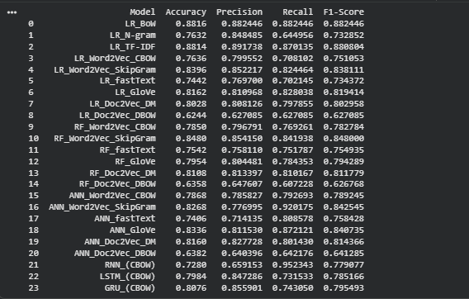
Model Accuracy with Different embedding techniques

Slide 5
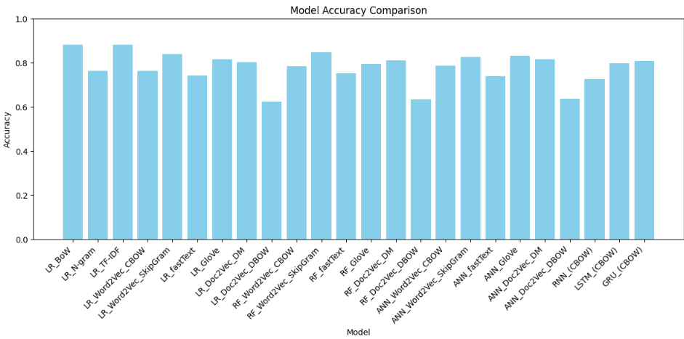
Accuracy Graph & Conclusion

